Slide 1


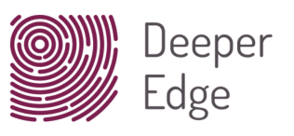

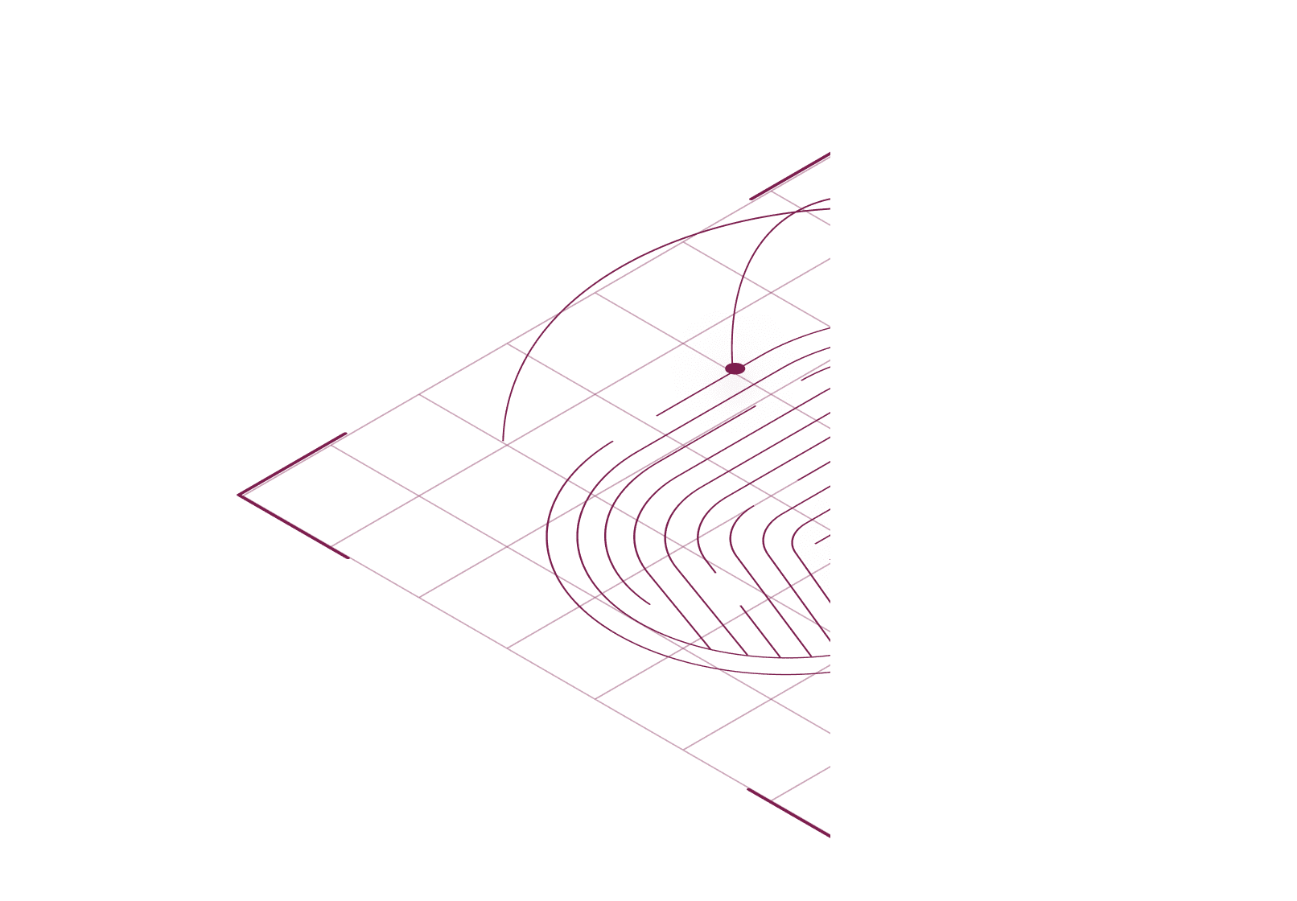











Deeper Edge LLC
Bringing Fiduciary Duties to the Web:
Building a Virtual Trust Layer
December 2021
Richard Whitt | richard@deeperedge.net
© 2021 Deeper Edge LLC All rights reserved.

Slide 2
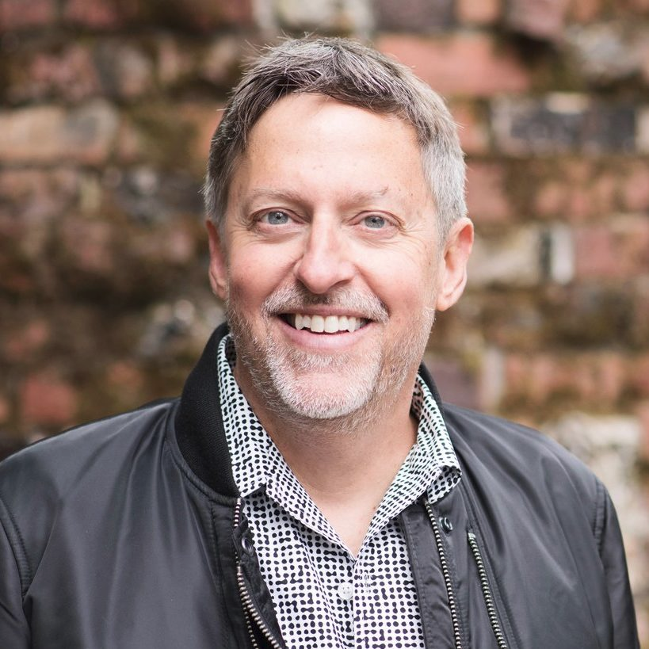
Introductions
Expertise
Corporate strategist
Tech policy attorney
Former longtime Googler (corp. director for strategic initiatives)
Current
Founder of Deeper Edge LLC
President of GLIA Foundation
Mozilla Foundation fellow in residence
Georgetown U. Tech Law Institute fellow
Formal advisor to Web-based startups
Experience
Thirty-plus years in Web company policy, legal, and strategy
Richard Whitt

Slide 3
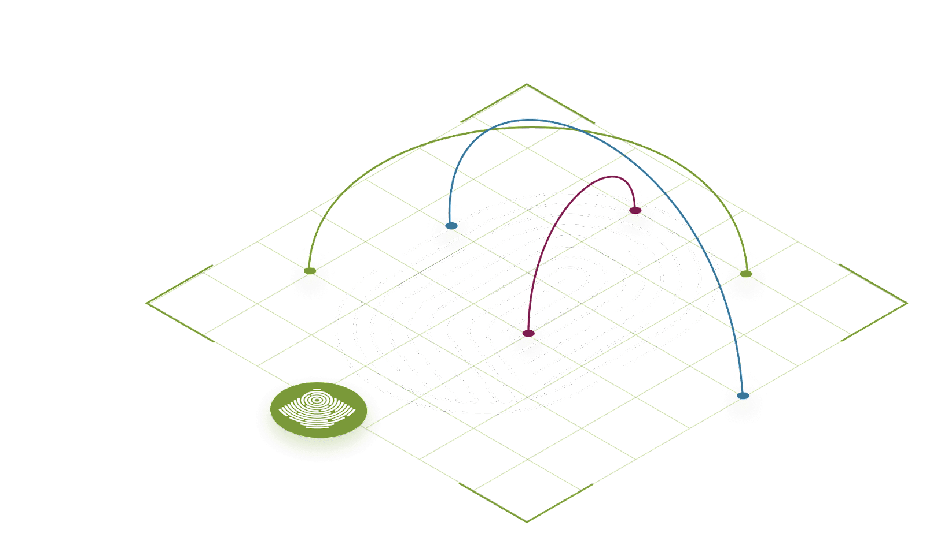
GLIAnet: Web Ecosystem Founded on Virtualized Trust Fabric (Human + Tech)
GLIAnet (www.glia.net) is a proposed new virtualized overlay to the Web, comprised of trustworthy intermediaries (such as digital fiduciaries) and human-centric technologies (edgetech).
Together, these elements serve as a form of virtualized trust fabric, designed to promote human trust, support, and autonomy.

Slide 4
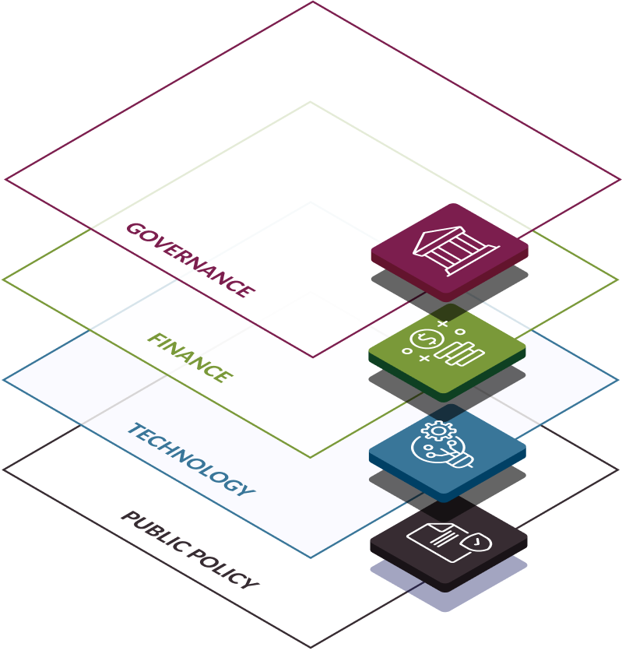
GLIAnet’s Multi-Layered Virtualized Trust Fabric
Governance Developing digital fiduciaries, as a form of trustmediaries
Finance Balancing online markets of empowered buyers vis-à-vis sellers
Technology Implementing edgetech applications, services, and devices
Public Policy Creating policy inputs for governance/finance/tech innovations

Slide 5





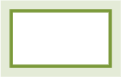




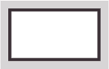




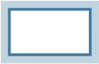
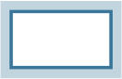
GLIAnet’s Virtualized Trust Fabric
Reference Architecture
This prototype architecture demonstrates how GLIAnet functionalities -- as employed by a digital fiduciary -- can help protect, enhance, and promote the individual’s datafied self.
In this scenario, offerings are provided from within the individual’s personal data ecosystem, scaling with evolving agency and trust levels.
Authorization Manager
Access Gateway from/to Individual
Relationship Manager
Personal Data Repository
Digital Fiduciary
Individual
Identity Manager
Personal AI
HUMAN
Edge
Web

Slide 6


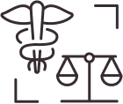
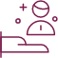


What is a Digital Fiduciary?
A Digital Fiduciary is an individualized agent for one’s online interactions, operating as a bona fide fiduciary.
The “fiduciary” part means duties of care and loyalty -- like doctors (health), attorneys (law), or financial advisors (money). For your digital self.
This agent serves the full human -- as individual, family member, community member, engaged citizen. Protecting, enhancing, and promoting her best interests.
The “digital” part means an agent safeguarding your Web interests. Not just personal “data,” but all your online actions and interactions: your digital lifestreams.

Slide 7
March 2021: Deeper Edge launches as GLIAnet “Proof of Concept”
No digital fiduciaries exist to date. Why?
Deeper Edge (www.deeperedge.net) conducts landscape analysis, explores aspects of viability, scalability, supply, and demand.
Initial proposed model was a B2C platform to provide Web-derived services directly to consumers. Web Guardian, LEVIT, and Personal AI are three examples.
B2C approach proves uncertain on several fronts.
B2X model -- providing fiduciary-based offerings for a wide variety of trustmediaries and use cases -- appears more sustainable and scalable.

Slide 8
December 2021: Pivoting to a B2X “Virtual Trust Layer”
Notable attributes
Business-to-any (B2X) model: wholesale offering, embedded in existing operations and policies of a wide range of potential trustmediaries: online, enterprise, not-for-profit, and municipal entities.
Open source/open access: developed and provided on a fee-free basis to all comers.
Multi-layered: cuts across network layers and data lifecycles.
Modular: mixing and matching discrete modules to suit particular situations – from devising agential privacy policies, to designing humanistic interfaces, to defining and applying duties to data flows, to analyzing end-to-end systems.
Adaptive: powering variety of use cases, including online presence, mobile, enterprise, smart cities/IoT, Web 3.0/blockchain, and AR/VR/MR “meta” platforms.

Slide 9
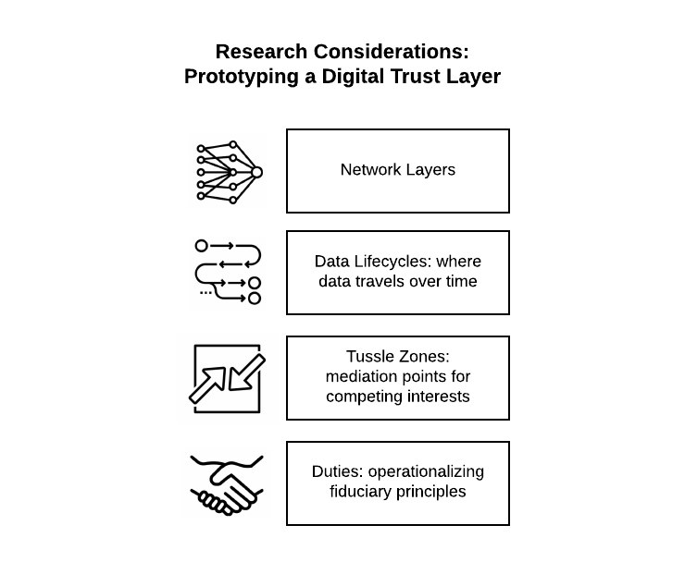
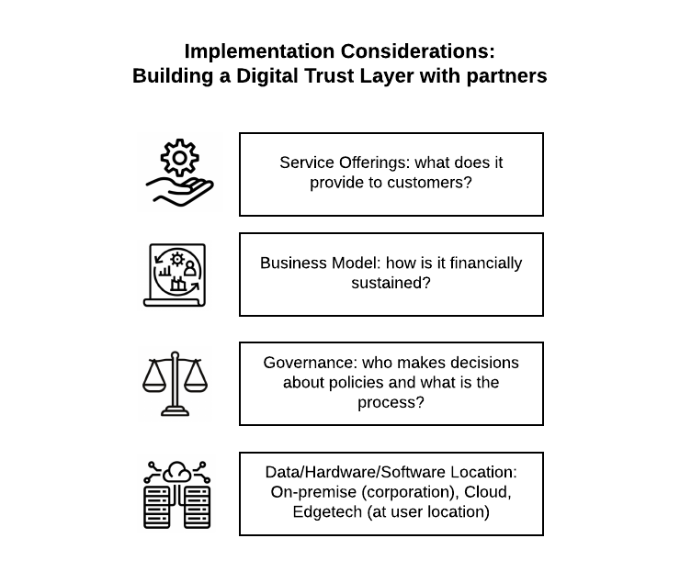
Elements of a Virtual Trust Layer and Its Enabling Ecosystem
Research Considerations:
Prototyping a Virtual Trust Layer
Implementation Considerations:
Building a Virtual Trust Layer with Partners

Slide 10
The Virtual Trust Layer: Interoperable Modules
Network Stacks: where data packets travel through layers of information systems.
Data Lifecycles: where data resides in servers, routers, algorithms, and applications.
Algorithmic Tussle Zones: recognizing external interfaces (“screens and scenes”), and intra-network mediation points (“unseens”), where competing interests “tussle” for control over data access and analytics decisions.
Duties: defining and fully operationalizing applicable obligations, based on extant laws of fiduciaries, trusts, and/or bailments.

Slide 11
The Virtual Trust Layer: Ecosystem Components
Middleware coding: translating digital trust layer capabilities into a data fiduciary “engine,” comprised of open source software readily adapted by any entity.
I/O Hooks: aligning each modular element of the VTL with corresponding IT inputs and outputs of the target entity.
Dependencies: identifying existing “legal hacking” opportunities (exploitable mechanisms in laws/regulations/policies) and market barriers (such as lack of uniform platform interoperability, data portability, and authorized agent delegation).
Accountabilities: deriving potential mechanisms of accountability and enforcement, from governmental laws and regulations, to standards, certifications, best practices, and codes of conduct.

Slide 12
The Virtual Trust Layer: Ecosystem Components
Landscape Census: cataloging full array of decentralized Web technologies, and their implementing B2C/B2B entities that could benefit from the VTL.
Data Fiduciaries Alliance: forming a coalition of like-minded entities, acting collaboratively as multi-stakeholders to serve in a variety of capacities to steer this new Web paradigm.
Public Policy Agenda: advocating for government laws and policies that would transform commercial dependencies into policy inputs.

Slide 13
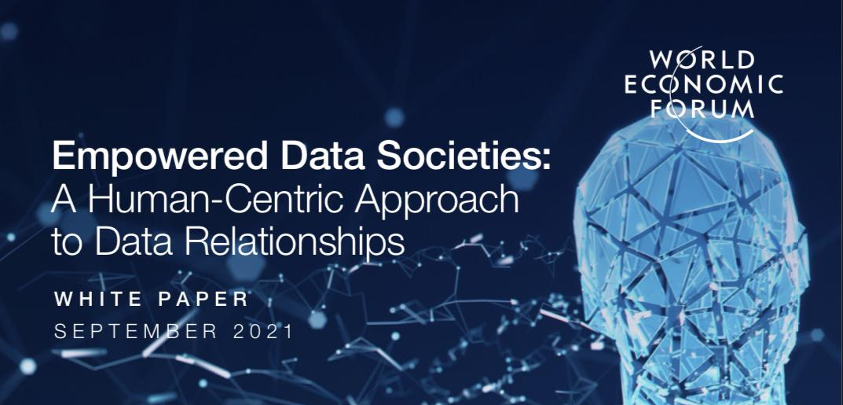
Early Progress
Fall 2021: Conversations commence with commercial entities and non-profits, to assess viability and potentially roles in a digital trust layer-based ecosystem; notable signups gained.
September 2021: World Economic Forum white paper released, validating VTL-informed process to identify competing data interests/tussle points in the City of Helsinki.
November 2021: Presentation of VTL to Mozilla’s Data Futures Lab; LinkedIn discussion group formed to seek feedback on pilots and coalition ideas.

Slide 14
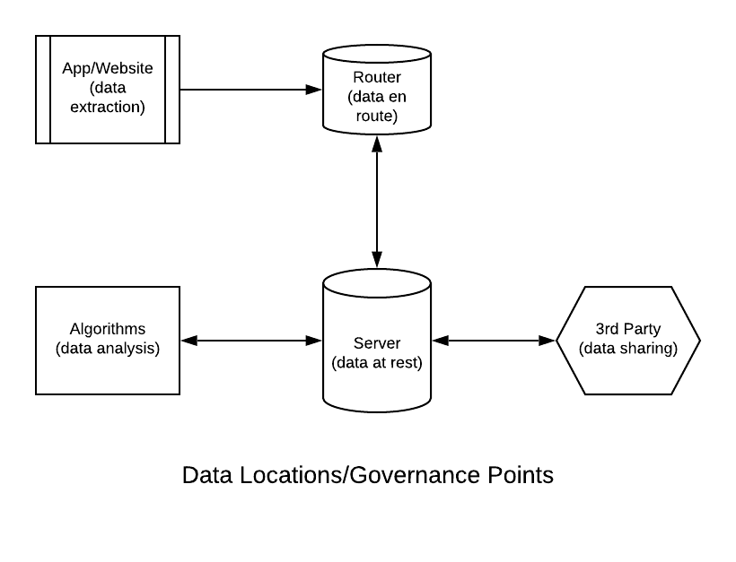
Layers and Stacks: Recognizing Discrete Decision Points

Slide 15
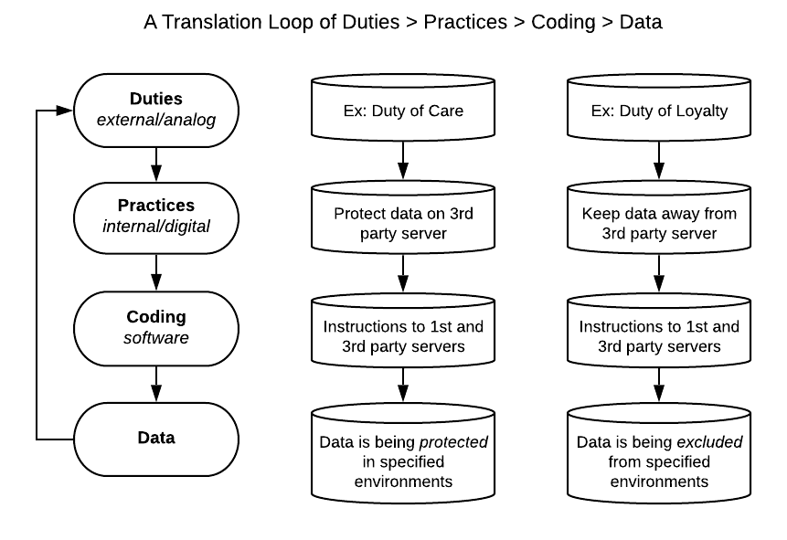
Virtual Trust Layer – How It Works

Slide 16
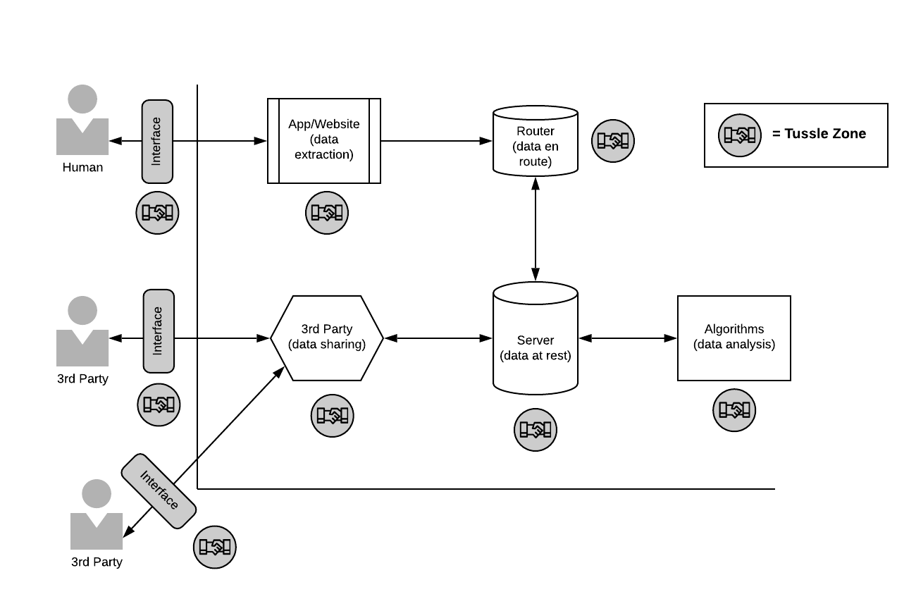
Governance Architecture: A Sample Schematic

Slide 17
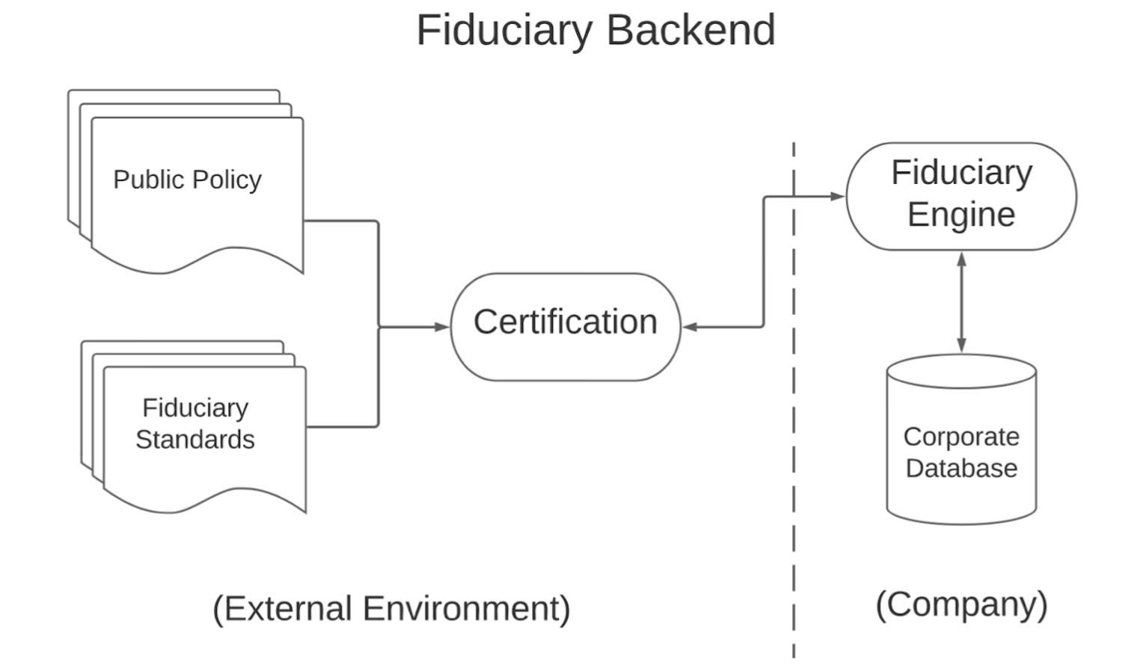
Virtual Trust Layer: Considering a Fiduciary Backend
A high-level starting point for asking “What would this platform look like?”
One representative example: engaging in discovery process with specific partners

Slide 18
Some Likely Use Cases for Virtual Trust Layers
Online company -- setting agential terms of service/engagement
Enterprise company -- setting dual authorized use policy
Mobile apps -- setting user privacy policy
Transborder data flows -- setting bailment duties attendant to global movement of data
Smart cities governance -- setting terms of citizen interactions
DAO -- setting humans in the loop of “trustless trust” arrangements
Metaverse platform -- setting novel multidimensional governance ethos

Slide 19
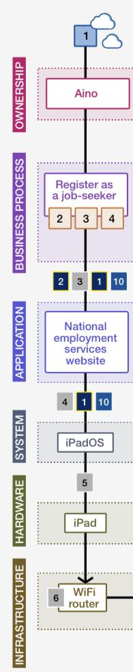
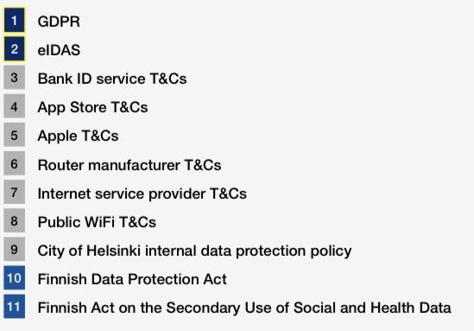
Recent Example : WEF/City of Helsinki
World Economic Forum initiative (September 2021) developed a similar approach for the City of Helsinki, grounded in data lifecycles, network layers, and “tussle points.”

Slide 20
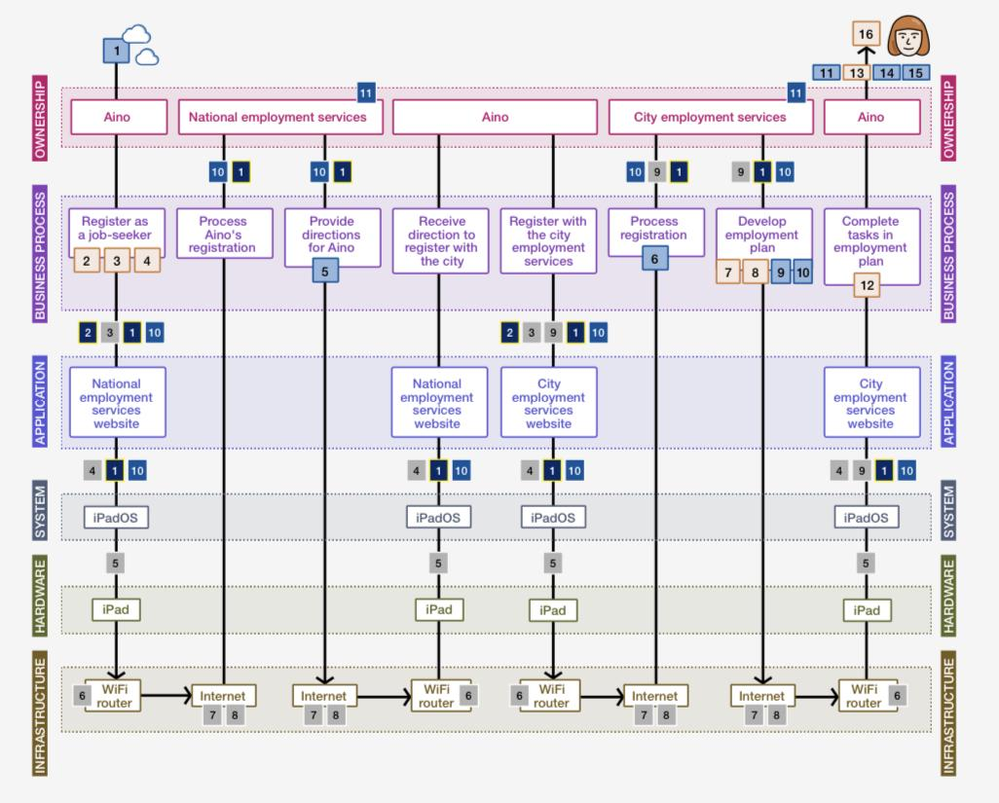
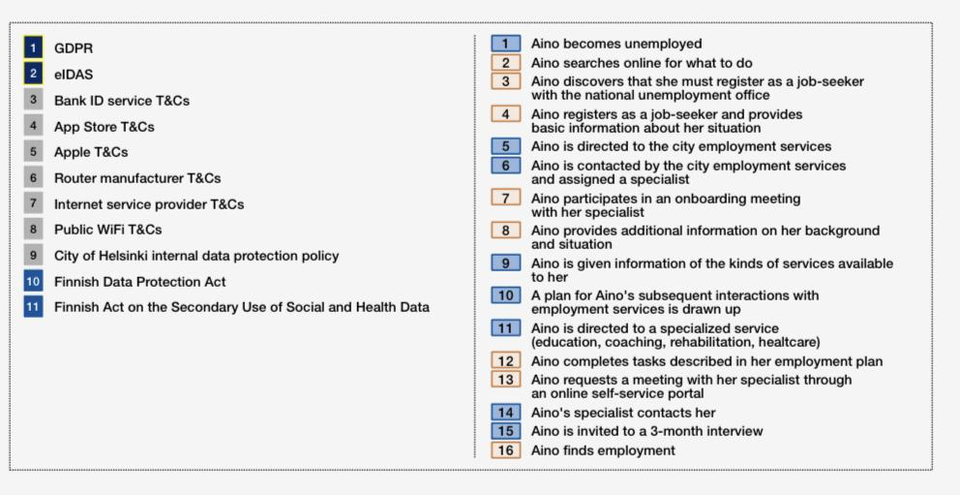
City of Helsinki: A Holistic Data Governance View

Slide 21
Towards the Future: VTL as Basis for New Web Ecosystem
Technology: introducing edgetech, based on “e2a” (edge-to-any/all) design principle
Offerings: instantiating both edge-push (intentions, requests) and edge-pull (content) capabilities
Business models: rebalancing lopsided markets; for example, moving from extractive cloud advertising to purposeful edge “intentcasting”
Governance: tying express fiduciary duties to tussle zone decisions
Public Policy: gaining new statutory rights, including interop, portability, delegation, and query/interrogation (with Personal AI), and assigning new statutory duties (of care, good faith, confidentiality)

Slide 22
Opportunities to Devise a New Trust-Based Web Paradigm
A cross-functional alliance can help bring to life a virtual trust layer-based ecosystem. Opportunities include:
Technology Testbeds
Open Source Contributors
Governance Collaborations
Commercial Partnerships
Policy Advocates
Ecosystem Funders

Slide 23











Less Extraction, More Action
Deeper Edge seeks to advance truly human-centered governance, technologies, business models, and public policies.
The virtual trust layer can be an important tool in achieving that mission.
Please join us.

Slide 24

Thank you!
Richard Whitt | info@deeperedge.net
deeperedge.net

